Slide 1
Generics – nullable – collection types
Continuous staff improvement project
Rami Atieyeh

Slide 2
Introduction
Generics
Nullable types
Enumerations (enums)
Collections (array lists – lists – dictionary)
Equality comparisons

Slide 3
Generics
Introduced with C# 2.0
Concept – Type parameters
Makes it possible to design classes and methods that defer the specification of one or more types until the class or method is declared and instantiated by client code.
Is applied on classes, interfaces, structures or methods.

Slide 4
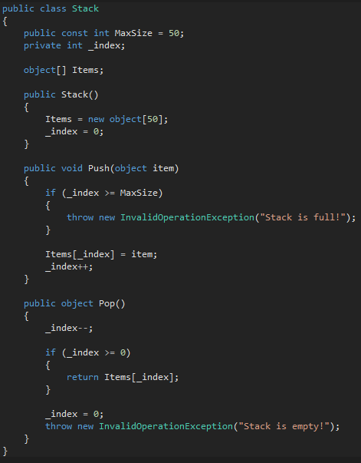
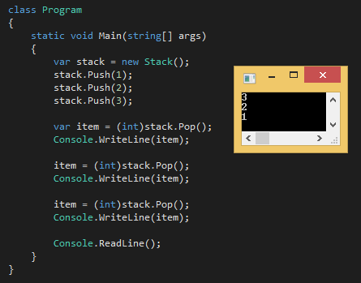
Without generics
Example of simple stack implementation
Works well so far, but have problems
What problems?

Slide 5
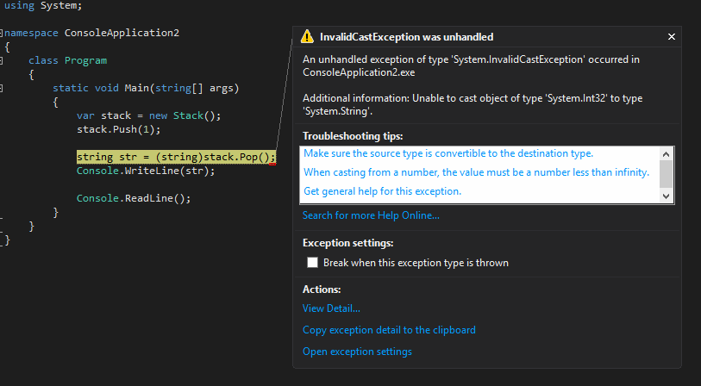
Non-Generic problems
Performance
Box the values (push)
Unbox the values (pop)
Boxing and Unboxing incurs a performance penalty
Also, results in more garbage collections – more performance penalties
Type safety
Compiler allows casting to anything from object
More severe problem

Slide 6
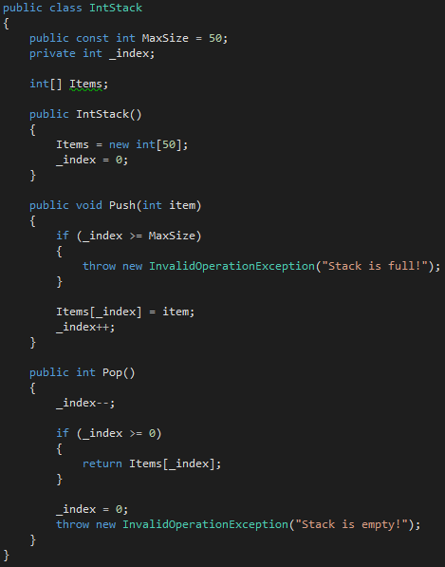
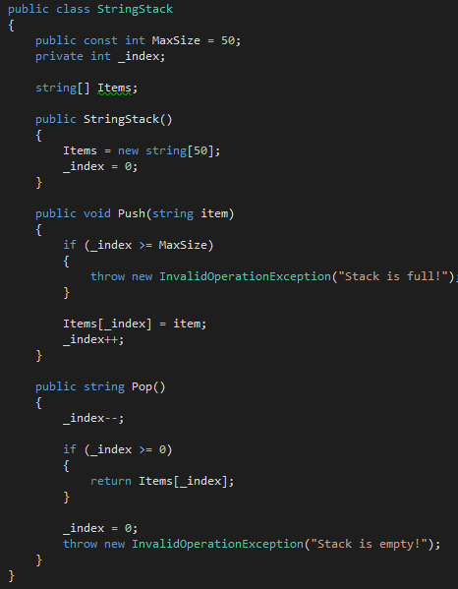
Non-generic problems Solutions
Implement type-specific classes.
Example

Slide 7
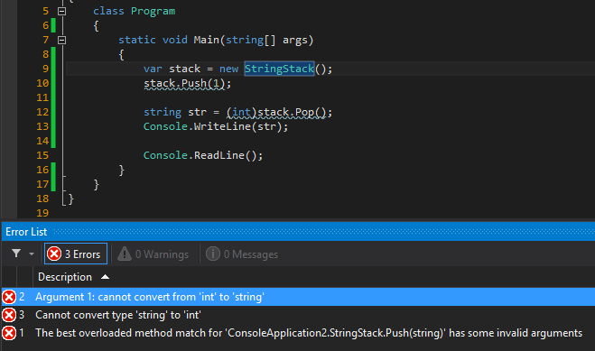
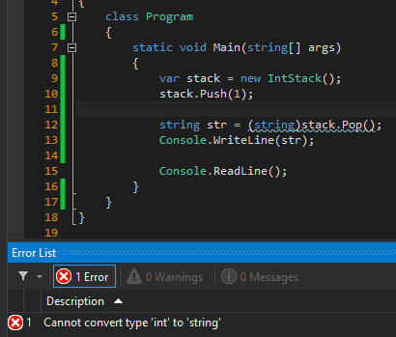
Non-generic problems solutions
Still a problem – Productivity impact.
Writing type-specific data structures is a tedious, repetitive, and error-prone task.
Fixing any defect in the data structure, will have to fix it not just in one place, but in as many places as there are type-specific duplicates.

Slide 8
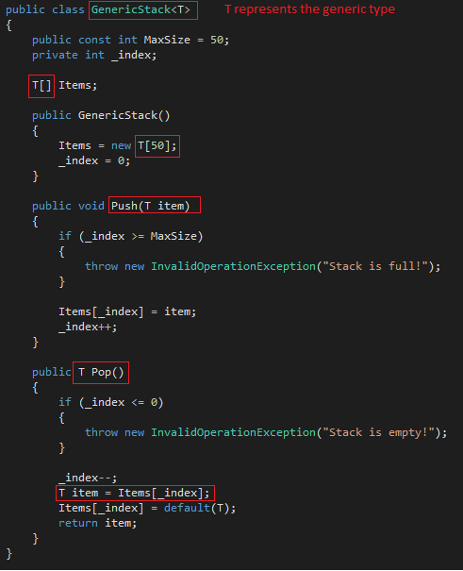
Back to generics
How to implement using generics
T is called the generic type parameter
GenericStack is called the generic Type
T can be of any type – also can use any other word/letter
Using the letter T is a convention – Shorthand for Type

Slide 9
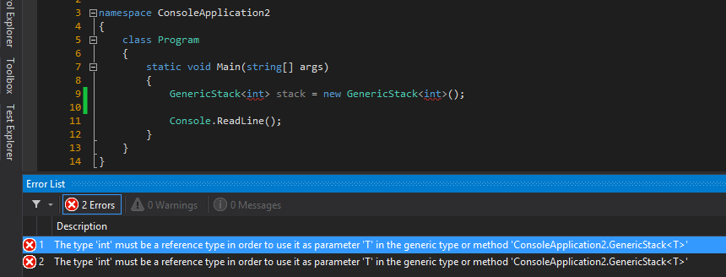
Generic constraints
Example
Forcing the type parameter to be a reference type (not a value type)

Slide 10
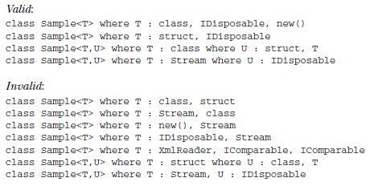
Generic constraints
We can apply restrictions to the kinds of types that client code can use for type arguments when it instantiates your class.
If client code tries to instantiate your class by using a type that is not allowed by a constraint, the result is a compile-time error.
These restrictions are called constraints. Constraints are specified by using the where contextual keyword. The following example lists valid and invalid constraints

Slide 11
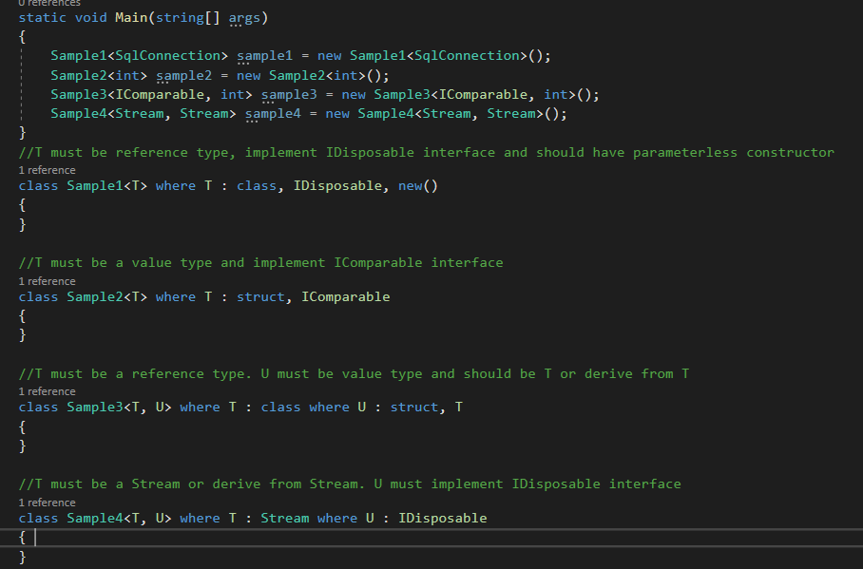
Generic constraints

Slide 12
Nullable types
Nullable types can represent all the values of an underlying type, and an additional null value.
Declaration
System.Nullable<T> variable
T? variable
T is the underlying type of the nullable type. T can be any value type including struct; it can not be a reference type.
System.Nullable is a struct, not a class.

Slide 13
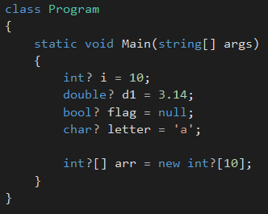
Nullable types - Examples

Slide 14
Nullable types - members
Each instance of a nullable type has two public read-only properties:
HasValue: is of type bool. It is set to true when the variable contains a non-null value.
Value: is of the same type as the underlying type.
If HasValue is true, Value contains a meaningful value. If HasValue is false, accessing Value will throw a InvalidOperationException.

Slide 15
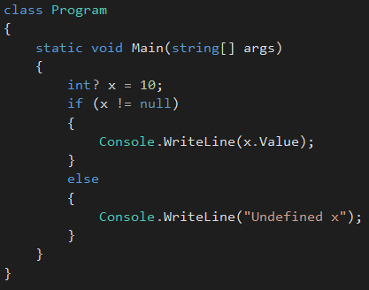
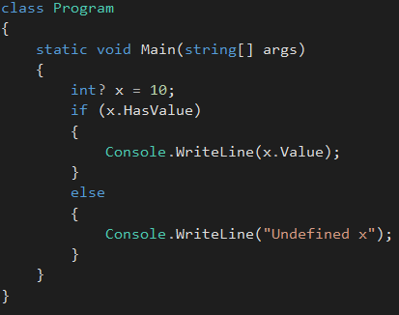
Nullable types - members
Example
Same thing

Slide 16
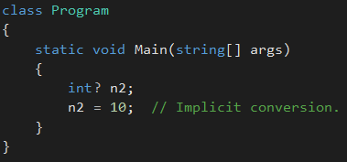
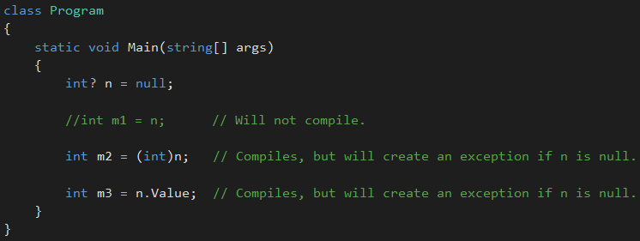
Nullable types - conversions
Implicit conversions
The value 10 is of type int – converted to int?
Explicit conversions

Slide 17
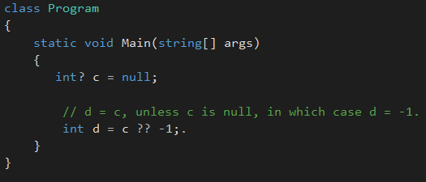
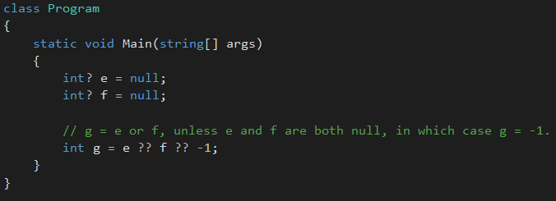
Nullable types - ?? operator
Defines a default value that is returned when a nullable type is assigned to a non-nullable type.
Can also be used with multiple nullable types

Slide 18
Enumerations (enums)
Provides an efficient way to define a set of named integral constants that may be assigned to a variable.
The enum keyword is used to declare an enumeration, a distinct type that consists of a set of named constants called the enumerator list.
Example – Days of the week
Only seven meaningful values which that variable will ever store.

Slide 19
Enumerations (enums)
Every enumeration type has an underlying type, which can be any integral type except char.
byte, sbyte, short, ushort, int, uint, long, or ulong.
The default underlying type of enumeration elements is int.
Example – Enum with byte underlying type
By default, the first enumerator has the value 0, and the value of each successive enumerator is increased by 1.
Can use initializers to override the default values,

Slide 20
collections
ArrayList
List
Dictionary
Set
Others

Slide 21
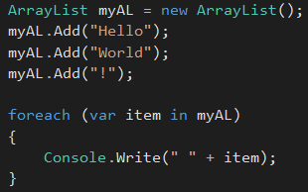
Array Lists
ArrayList Class - Implements the IList interface using an array whose size is dynamically increased as required.
Elements in this collection can be accessed using an integer index. Indexes in this collection are zero-based.
Not strongly-type

Slide 22
List<T>
List<T> Class - Represents a strongly typed list of objects that can be accessed by index. Provides methods to search, sort, and manipulate lists.
The List<T> class is the generic equivalent of the ArrayList class. It implements the IList<T> generic interface by using an array whose size is dynamically increased as required.
Elements in this collection can be accessed using an integer index. Indexes in this collection are zero-based.
Has lots of methods for search and change data.
Ideal for elements accessed by indexes (not string keys).

Slide 23
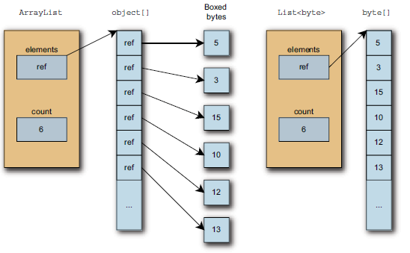
Arraylist VS List<T>

Slide 24
List<T> - some methods
Clear – Removes all elements from the list
Contains – Determines whether an element is in the list
IndexOf - Searches for the specified object and returns the zero-based index of the first occurrence within the list.
Insert - Inserts an element into the list at the specified index.
Remove - Removes the first occurrence of a specific object from the list.
ToArray - Copies the elements of the list to a new array.

Slide 25
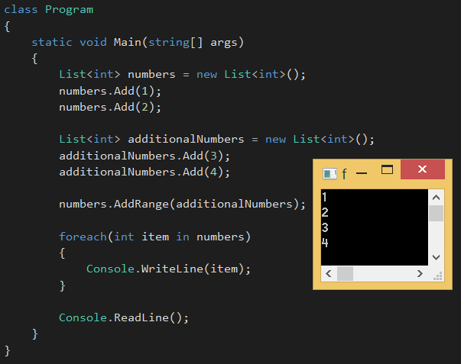
List<T>
Example
Add – AddRange methods

Slide 26
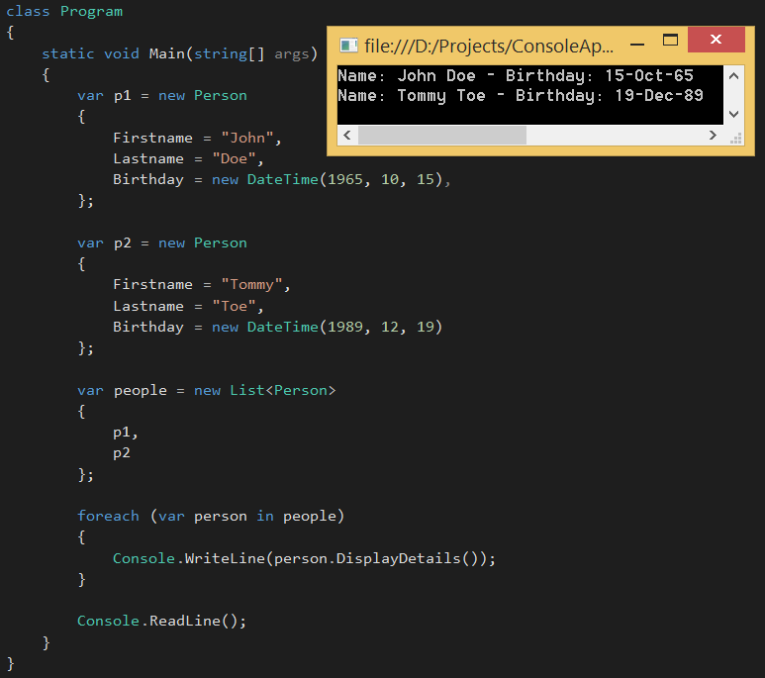
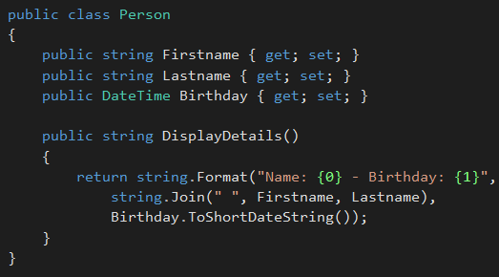
List<T>
Another example

Slide 27
Dictionary<TKey, TValue> Class
Represents a collection of keys and values.
Type parameters
Tkey – The type of the keys
Tvalue – The type of the values
Provides a mapping from a set of keys to a set of values. Each addition to the dictionary consists of a value and its associated key.
Getting a value from dictionary by key is very fast.
When iterating through items in a dictionary, we get a series of KeyValuePair objects.

Slide 28
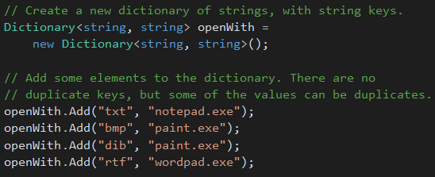
Dictionary<TKey, TValue> Class
Example

Slide 29
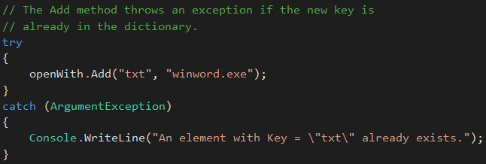
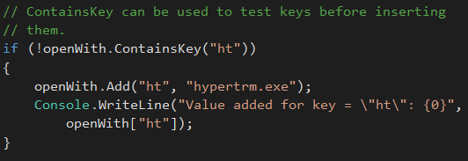
Dictionary<TKey, TValue> Class
Example

Slide 30
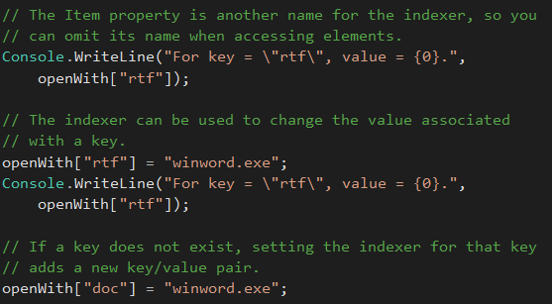
Dictionary<TKey, TValue> Class
Example

Slide 31
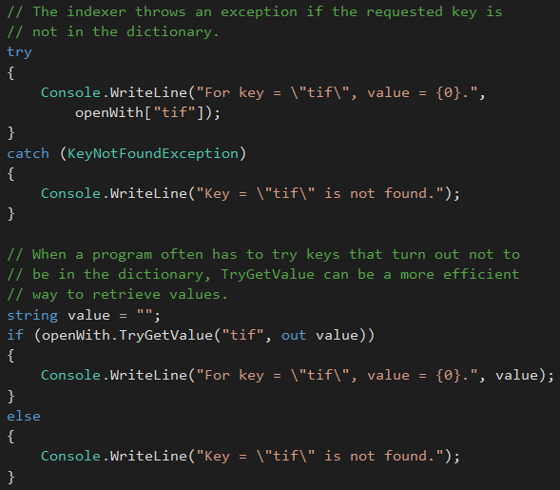
Dictionary<TKey, TValue> Class
Example

Slide 32
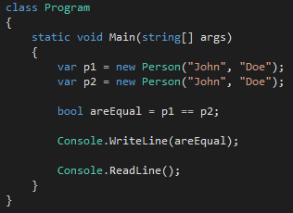
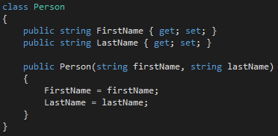
Equality comparison
Output ?
Are equal ?
Two different objects – referencing two different memory addresses

Slide 33
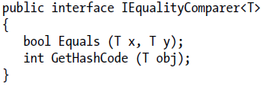
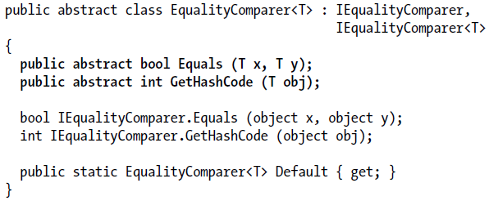
Equality comparison - IEqualityComparer
IEqualityComparer<T> interface - Defines methods to support the comparison of objects for equality.
Contains two methods
Alternetive – EqualityComparer<T> class
Simply override the two abstract methods

Slide 34
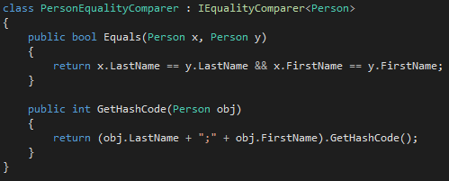
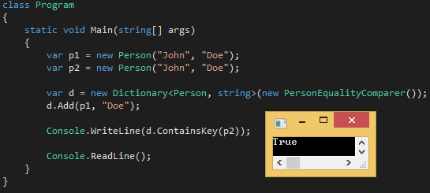
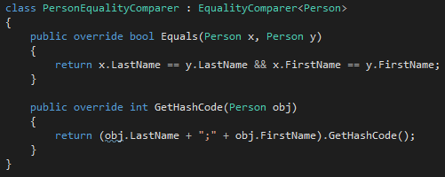
Equality comparison - IEqualityComparer
Example
OR

Slide 35
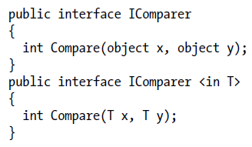
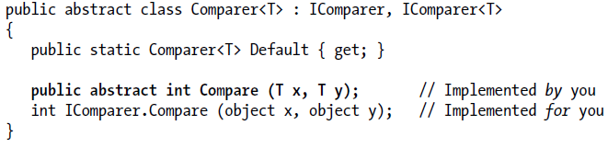
Equality comparison – Icomparer and comparer
Comparers are used to switch in custom ordering logic for sorted dictionaries and collections.
Necessary for lists and array lists – for sorting
IComparer – Icomparer<T> - Interfaces definitions
Alternative – Comparer<T> class

Slide 36
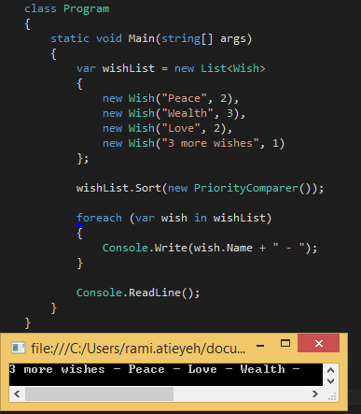
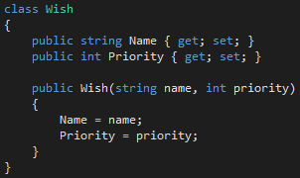
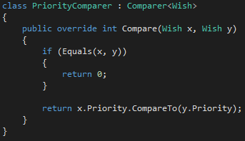
Equality comparison – Icomparer and comparer
Example

Slide 37
Assignment
Create a generic Collection class (using array []) having following operations
Get item at given index
Set item at given index
Swap two items (either by indexes or by items or both)
In the previously made real world object modelling application:
Add Nullable Properties/Fields
Add Enums
Add Collections and Dictionaries
Implement Generic Repository Pattern
Additional:
Implement comparer and equality comparisons.
Investigate Generic Covariance and Contravariance

Slide 38
References
Albahari J, Albahari B (2012). C# 5.0 in a Nutshell
MSND – Nullablbe Types
MSDN - Arrays
MSDN – ArrayList
MSDN – List
MSDN – Dictionary
MSDN - Enumeration

